Slide 1
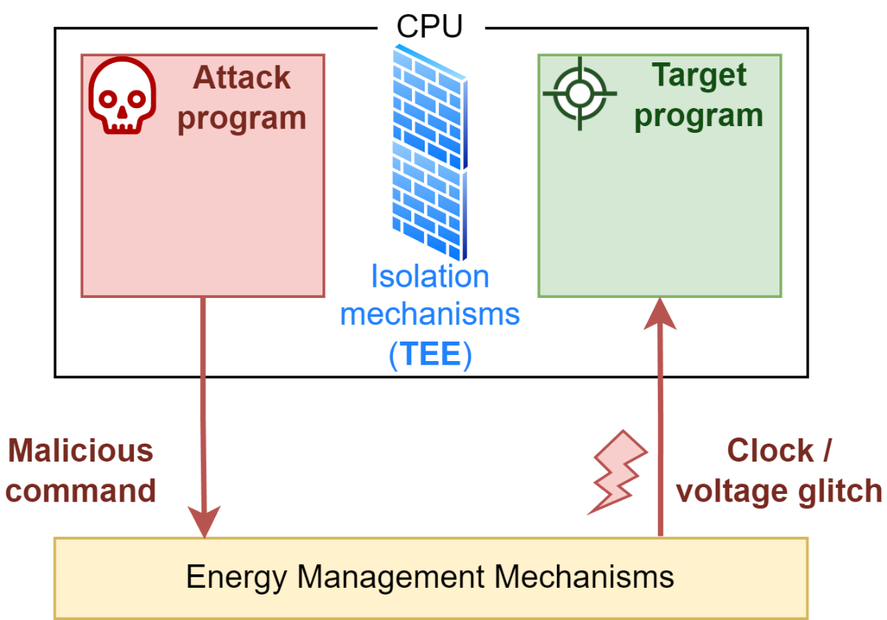

Developments in the security of energy management modules against remote fault injection attacks
Projet ANR JCJC CoPhyTEE
Sécurisation de systèmes sur puce à base d’architecture open-source contre des attaques physiques réalisées à distance basées sur l’énergie
ANR-23-CE39-0003-01
Gwenn Le Gonidec (IETR)
Maria Méndez Real (Lab-STICC, UBS)
Guillaume Bouffard (ANSSI)
Jean-Christophe Prévotet (IETR, INSA Rennes)
owen.le-gonidec@insa-rennes.fr

Slide 2
Context

Slide 3
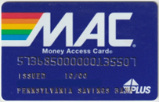
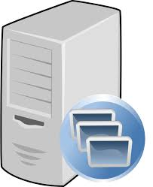

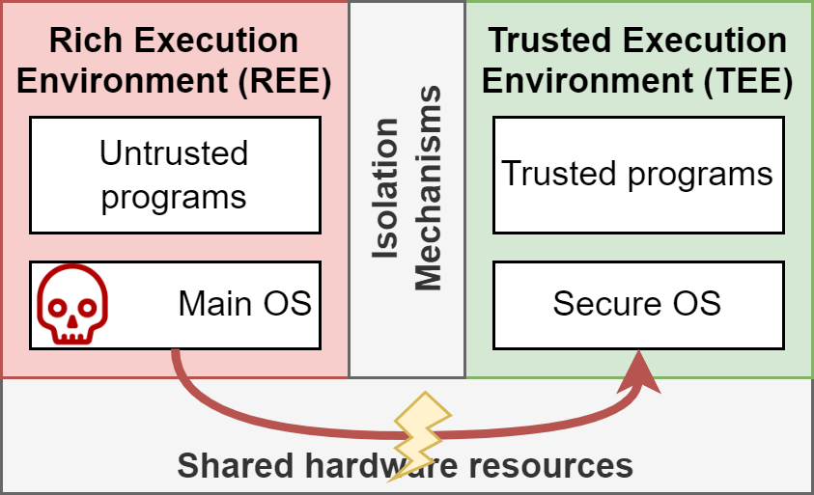
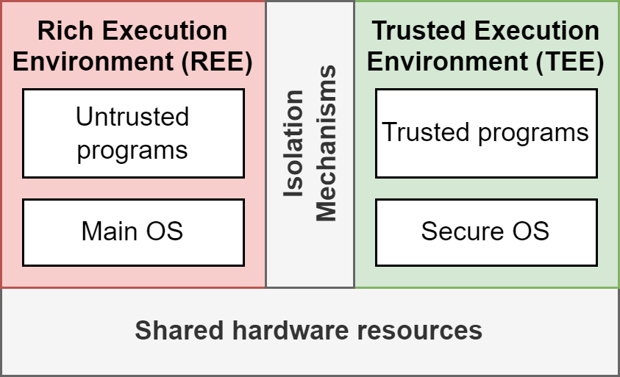
From Secure Elements to Trusted Execution Environments
Secure Element
Complex Systems (SoCs, servers, etc.)
Simple system
Small attack surface
Heterogen, versatile and powerful → Balance between performance, power constraints and security
Large attack surface (software and hardware)
Securing third-party programs
Software-induced hardware attacks emerge from the complexity of the host system.
Hardware attack methods
Software attack → Mass remote exploitation is possible
→ Trusted Execution Environments (TEEs) (e.g., Arm Trustzone, Intel SGX)
Many devices and applications rely on TEEs:
Servers (confidential cloud computing)
Applicative SoCs and commodity devices (biometry, DRMs, etc.)

Slide 4
Power-management-based attacks

Slide 5


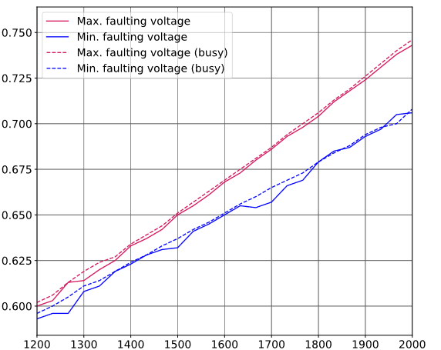

Power-management-based attacks
Attacker model
Attack
Software attacker, high privilege (controls drivers)
Target: trusted application executed on the same applicative multicore CPU
Through energy management mechanisms, the attacker controls the CPU’s frequency & voltage
→ Clock / Voltage glitch
Stable
Faults
Voltage (V)
Reset
¹ Mahmoud et al., DFAulted: Analyzing and Exploiting CPU Software Faults Caused by FPGA-Driven Undervolting Attacks, IEEE Access, vol. 10, 2022.
Frequency (MHz)
Re-printed from (¹)

Slide 6
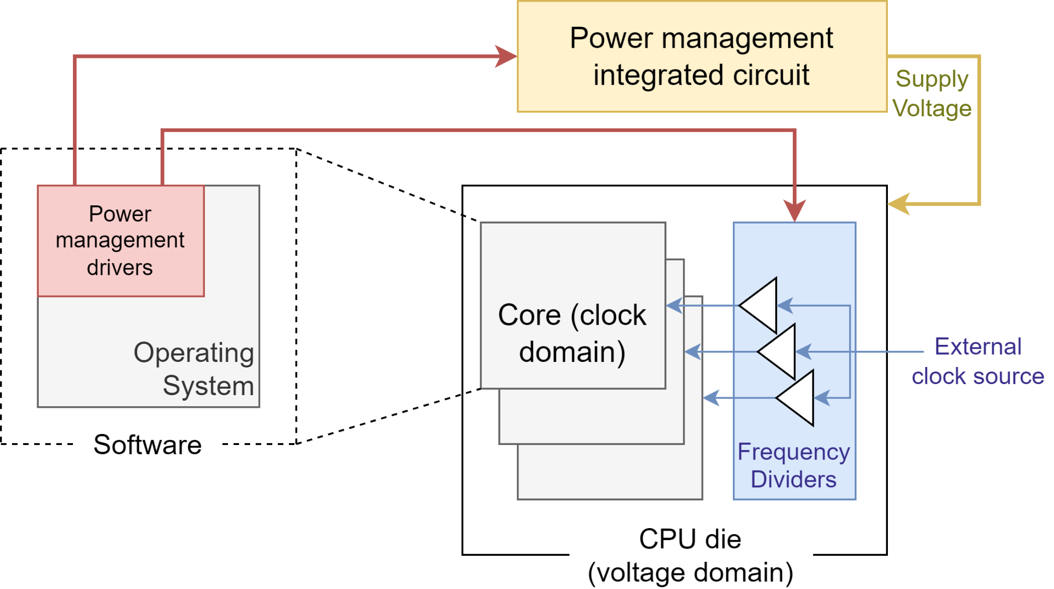

Energy management mechanisms
DVFS (Dynamic Voltage and Frequency Scaling)
Tang et al., CLKScrew: Exposing the Perils of Security-Oblivious Energy Management, USENIX Security 17, 2017.

Slide 7
Results
First attack: CLKScrew (2017)
→ Many similar attacks have been published^{1—5}
New target platforms
New attack scenarios
Vulnerable platforms and TEEs
A wide range of Arm Trustzone-based SoCs ^{1,2}
Intel CPUs protected by SGX ^{4,5} (Skylake)
Main fault model: The result of some operations is faulted (multiplications, vector operations, encryption)
Compromised security properties
Confidentiality
→ Cipher keys stored in the TEE extracted using DFA^{1,2,4}
Integrity
→ Out-of-Bounds memory access provoked⁴
Authenticity
→ Forcefully launched ill-signed programs in the TEE^{1,2}
Availability
→ Denial-of-Service attacks³
¹ Tang et al., CLKSCREW: Exposing the Perils of Security-Oblivious Energy Management, USENIX Security 17, 2017.
² Qiu et al., VoltJockey: Breaching TrustZone by Software-Controlled Voltage Manipulation over Multi-core Frequencies, AsianHOST, 2019.
³ Noubir et al., Towards Malicious Exploitation of Energy Management Mechanisms, DATE 2020.
⁴ Murdock et al., Plundervolt: Software-based Fault Injection Attacks against Intel SGX, IEEE Symposium on Security and Privacy (SP), 2020.
⁵ Kenjar et al., V0LTpwn: Attacking x86 Processor Integrity from Software, USENIX Security 20, 2020.

Slide 8
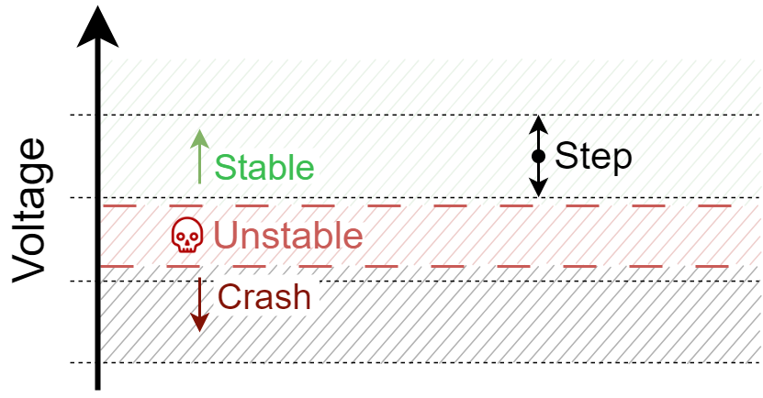
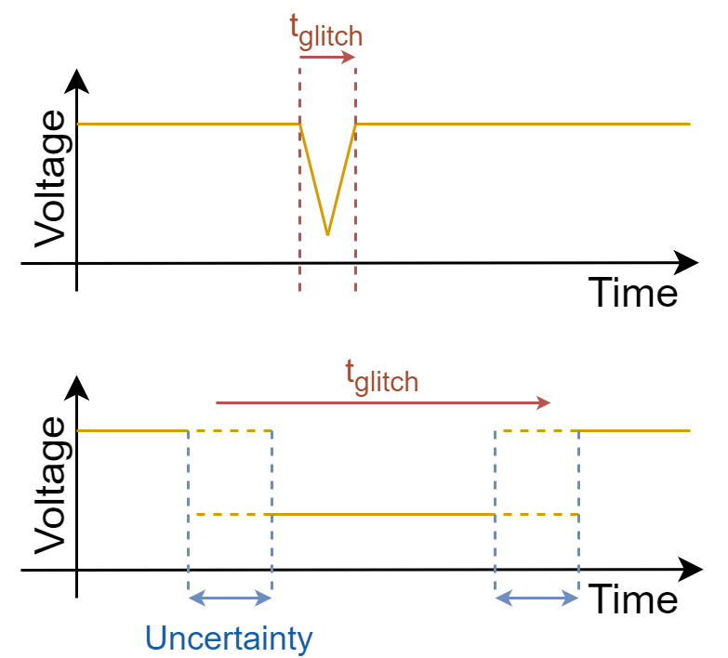
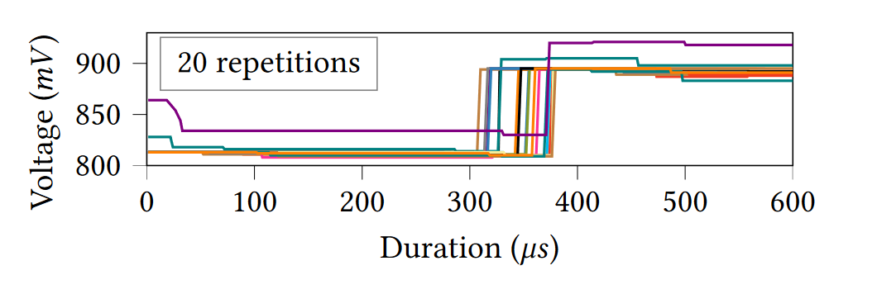
Limits of DVFS attacks
Voltage regulators can be imprecise
Timing accuracy
Re-printed from: Juffinger et al., SUIT: Secure Undervolting with Instruction Traps, 29th ACM International Conference on Architectural Support for Programming Languages and Operating Systems, 2024
Notes:
(SUIT: the CPU is an Intel Core i9-9900K)

Slide 9
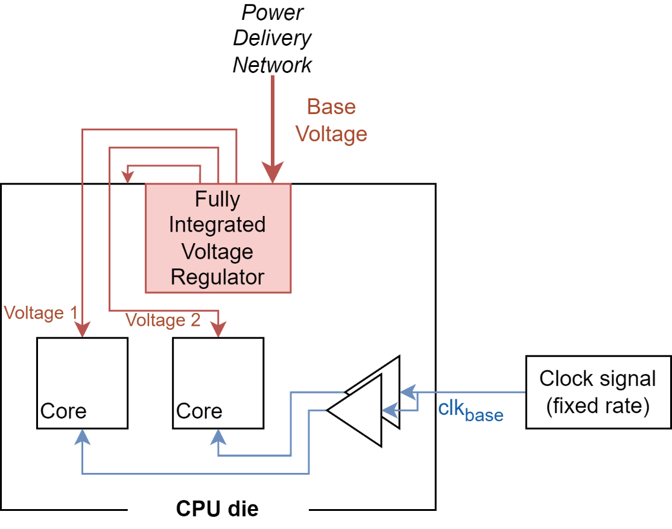
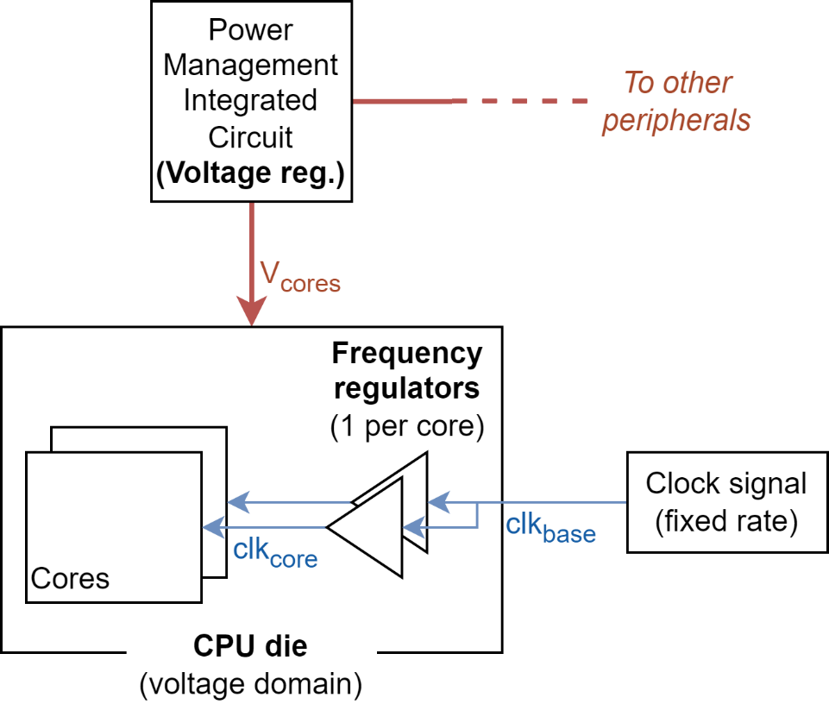
Potential evolutions
Combination with other attacks
Power management hardware evolution
New ways to manipulate voltage and frequency
Notes:
Some data. SUIT (2024): 335us (Intel Xeon), 668us (AMD Ryzen 7)

Slide 10
Countermeasures

Slide 11
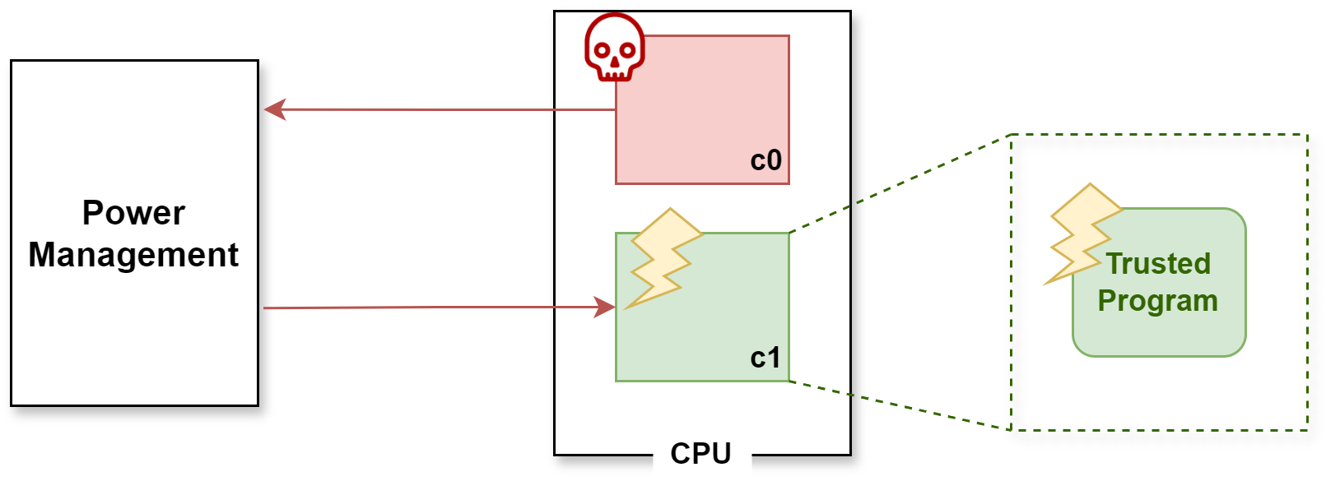

Approaches to countering DVFS attacks
Prevent malicious use of power management mechanisms by the attacker
Strengthen the hardware against voltage & frequency variations
Make trusted programs robust against fault attacks

Slide 12

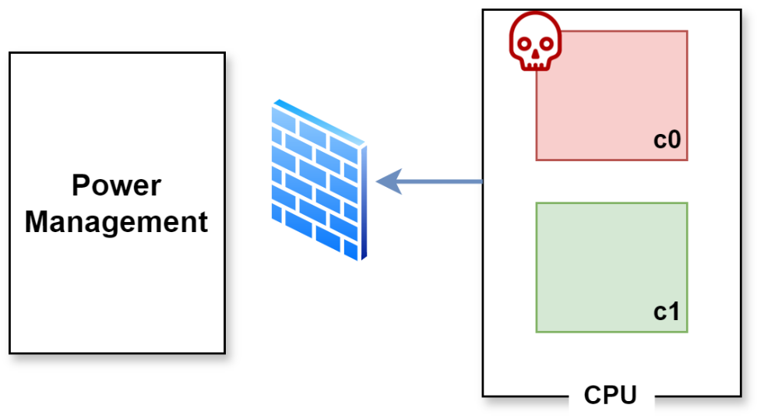
DVFS attacks countermeasures — First approach
→ Intel/Arm approach: prevent software from accessing voltage regulators
Impact on power management mechanisms?
Other ways to manipulate voltage (e.g. FPGA-to-CPU attack)
→ Use of a coprocessor to control voltage/frequency change requests
Cost and energy consumption of the component
Zhang et al., Blacklist Core: Machine-Learning Based Dynamic Operating-Performance-Point Blacklisting for Mitigating Power-Management Security Attacks, ISLPED '18: International Symposium on Low Power Electronics and Design, 2018

Slide 13
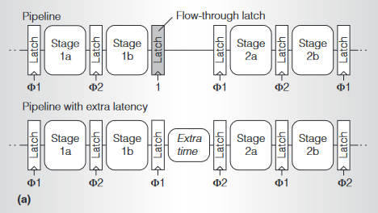
DVFS attacks countermeasures — Second approach
→ Increase the latency of frequently faulted instructions
Requires hardware modifications to the CPU
Impact on performances
Re-printed from Liang et al., ReVIVaL: A Variation-Tolerant Architecture Using Voltage Interpolation and Variable Latency, 2008 International Symposium on Computer Architecture
Juffinger et al., SUIT: Secure Undervolting with Instruction Traps, 29th ACM International Conference on Architectural Support for Programming Languages and Operating Systems, 2024

Slide 14
DVFS attacks countermeasures — Third approach
→ Well-known methods: redundancy, infection, error detection codes, etc.¹
→ Identify vulnerable code sections²
→ Insert new instructions to protect against attacks³
Heavy impact on performances
Useful against other fault injection attacks
¹ Tao et al., Software Countermeasures against DVFS fault Attack for AES, 10th International Conference on Dependable Systems and Their Applications (DSA), 2023.
² Zhang et al., iATPG: Instruction-level Automatic Test Program Generation for Vulnerabilities under DVFS attack, IEEE 25th International Symposium on On-Line Testing and Robust System Design (IOLTS), 2019
³ Kogler et al., Mineﬁeld: A Software-only Protection for SGX Enclaves against DVFS Attacks, 31st USENIX Security Symposium (USENIX Security 22), 2023

Slide 15
Conclusions

Slide 16
Conclusions
DVFS attacks: an important threat
Survey article
Do not Trust Power Management: A Survey on Internal Energy-based Attacks Circumventing Trusted Execution Environments Security Properties
(Pre-print available on arXiV:
https://doi.org/10.48550/arXiv.2405.15537)
Wide range of vulnerable applications and devices
Software attack → remote and mass exploitation
Many possible evolutions → Impact of the evolution of power management mechanisms on the attack surface? → What are the other ways to control voltage & frequency?
Prospects for countermeasures
Arm Trustzone, Intel SGX: limited and specific countermeasures
Thanks for your attention!
→ How to design TEE implementations that are fundamentally secure against software-induced hardware attacks?
RISC-V TEEs are an opportunity

